Slide 1
Inheritance, Polymorphism, Packages and Interfaces

Slide 2
Inheritance: Inheritance Hierarchies, super keyword – final keyword-final classes and methods. Polymorphism: dynamic binding, method overriding. Abstraction-abstract classes and methods. The Object class –– Object Cloning – Inner Classes-Garbage Collection - Finalize Method.
Packages and Interfaces -Interfaces - Interfaces vs. Abstract classes, defining an interface, implementing, Inner classes - uses of inner classes, local inner classes, anonymous inner classes, static inner classes. interfaces - extending interfaces.

Slide 3
Inheritance
Inheritance in Java is a mechanism in which one class acquires the properties (fields and methods) of another class.
It is a fundamental concept of object-oriented programming (OOP) that allows for code reusability and the creation of hierarchical relationships between classes.
The class that inherits properties is known as the subclass (or derived class or child class), and the class whose properties are inherited is known as the superclass (or base class or parent class).

Slide 4
Inheritance Types in Java
Single Inheritance – One subclass inherits one superclass
Multilevel Inheritance – Class B inherits A, Class C inherits B
Hierarchical Inheritance – Multiple classes inherit one superclass
Note: Java does not support multiple inheritance (via classes) directly to avoid ambiguity, but it supports it via interfaces.

Slide 5
Benefits
Code Reusability
Method Overriding
Polymorphism
Abstraction
Modularity

Slide 6
Method overloading vs method overriding
Method Overloading allows us to define multiple methods with the same name but different parameters within a class.
This difference can be in the number of parameters, the types of parameters, or the order of those parameters.
Method overloading in Java is also known as Compile-time Polymorphism, Static Polymorphism, or Early binding

Slide 7
Key features of Method Overloading:
Multiple methods can share the same name in a class when their parameter lists are different.
Overloading is a way to increase flexibility and improve the readability of code.
Overloading does not depend on the return type of the method, two methods cannot be overloaded by just changing the return type.

Slide 8
Method Overriding
Method overriding, in object-oriented programming, is a language feature that allows a subclass or child class to provide a specific implementation of a method that is already provided by one of its superclasses or parent classes

Slide 9
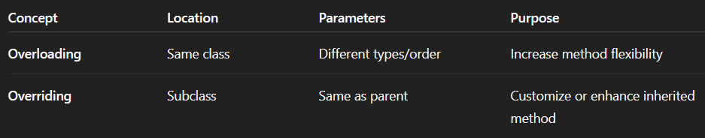
Method overloading vs method overriding

Slide 10
super Keyword
Super keyword is used to refer to the parent class in a subclass.
Call the parent class constructor.
Access methods and variables from the parent class.

Slide 11
Final keyword
Mark variables as constants.
Prevent method overriding.
Prevent class inheritance.

Slide 12
Final method

Slide 13
Final class

Slide 14
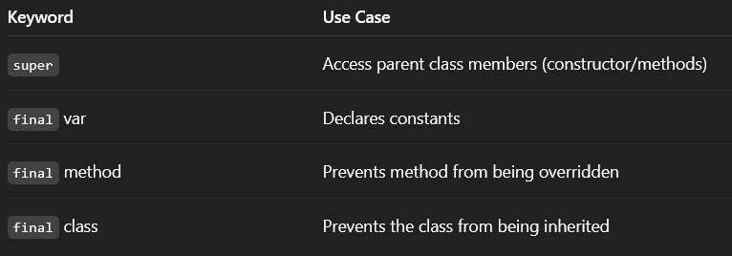
Behaviour of the final keyword

Slide 15
Polymorphism?
Polymorphism means "many forms". In Java, it allows us to perform a single action in different ways.
Compile-Time Polymorphism (Method Overloading)
Run-Time Polymorphism (Method Overriding)

Slide 16
Dynamic binding
Dynamic binding is the mechanism that determines which overridden method to call at runtime.
When the JVM decides at runtime which method to invoke, based on the object type the reference points to

Slide 17
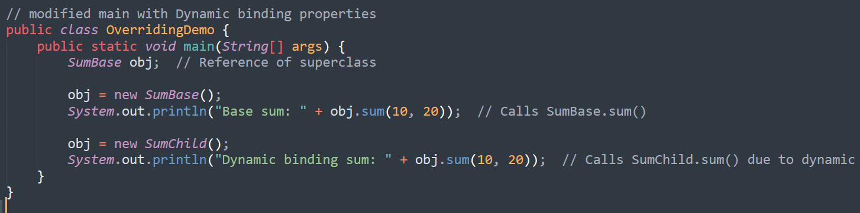
What is Method Overriding here? In our example
The SumChild class overrides the sum() method of SumBase
It changes the logic by adding +10 to the result.

Slide 18
Abstract classes
An abstract class is a class that cannot be instantiated (created directly).
It acts as a blueprint for other classes, defining a general structure or behavior.
Abstract classes can contain both abstract methods (without implementation) and concrete methods (with implementation).
An abstract class is declared using the abstract keyword.
Any class containing one or more abstract methods must also be declared abstract

Slide 19
Abstract Methods
An abstract method is a method declared without a body (implementation).
It specifies the method's signature (name, parameters, return type) but not the actual code that executes when the method is called.
Abstract methods must be implemented by subclasses that inherit from the abstract class.

Slide 20
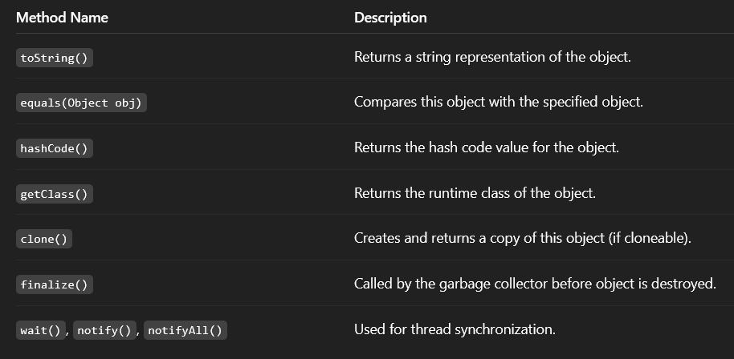
Object Class
Object class in Java is present in java.lang package.
Every class in Java is directly or indirectly derived from the Object class.

Slide 21
Abstraction- abstract classes and methods
Abstract is the modifier applicable only for methods and classes but not for variables.
Even though we don't have implementation still we can declare a method with an abstract modifier.
Abstract methods have only declaration but not implementation.
Abstract method declaration should compulsory ends with semicolons.

Slide 22
Garbage Collection
GC is the process of automatically identifying and removing unused (unreachable) objects from memory to free up resources and prevent memory leaks.

Slide 23
Finalize Method
It is a special method that used to be part of the object destruction process

Slide 24
Interfaces
An interface in Java is a blueprint of a behaviour.
A Java interface contains static constants and abstract methods.
Uses keyword implememts

Slide 25
Properties
The interface in Java is a mechanism to achieve abstraction.
By default, variables in an interface are public, static, and final.
It is used to achieve abstraction and multiple inheritance in Java.
It supports loose coupling (classes depend on behavior, not implementation).
In other words, interfaces primarily define methods that other classes must implement.

Slide 26
can we create object for interface?
Not possible

Slide 27
When to use classes and interfaces ??
To create real objects with properties and behaviors
When you have shared implementation (code)
When you need constructors, fields, method implementations, and inheritance
Note: Use Class when you have specific data and functionality.

Slide 28
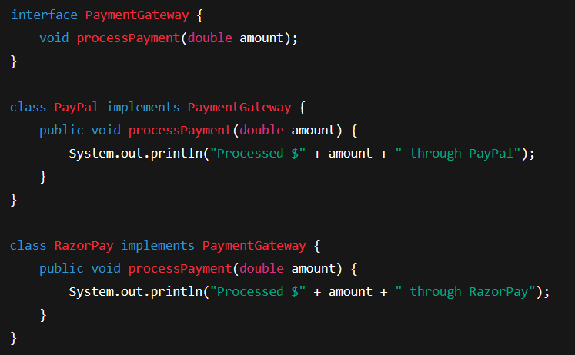
When to use interfaces ??
To define a contract or blueprint without implementation.
When you want to enforce rules across unrelated classes.
For loose coupling, polymorphism, and plug-and-play behavior.

Slide 29
Inner classes
Member Inner Class [A class defined within another class, but not declared as static]
Static Nested Inner Class [A static nested class in Java is a class declared within another class using the static keyword].
Local Inner Class [A local inner class in Java is a class defined within a block of code, typically inside a method.]
Anonymous Inner Class [An anonymous inner class in Java is a class without a name, defined and instantiated in a single statement. It is used to create objects of a class or interface with specific behavior, often for one-time use.]

Slide 30
Key characteristics of Anonymous Inner Class :
No Name: It has no explicit name.
Single Object: Only one object is created from it.
Extends or Implements: It either extends a class or implements an interface.
Defined Inside Another Class: It must be defined within another class (inner class).
No Constructor: It cannot have a constructor due to the lack of a name. However, it can use an instance initializer block for initialization.
One-Time Use: Typically used when a class is only needed once, avoiding the creation of a separate named class.

Slide 31
Error vs. Exception
Aspect | Error | Exception
Definition | An Error indicates a serious problem that a reasonable application should not try to catch. | Exception indicates conditions that a reasonable application might try to catch
Cause | Caused by issues with the JVM or hardware. | Caused by conditions in the program such as invalid input or logic errors.
Examples | OutOfMemoryError StackOverFlowError | IOException NullPointerException

Slide 32
Exception Handling
Exception handling in Java is a mechanism to manage runtime errors, ensuring the program's normal flow is maintained.
Exceptions are events that disrupt the program's execution, typically caused by unexpected conditions like invalid input or resource unavailability.

Slide 33
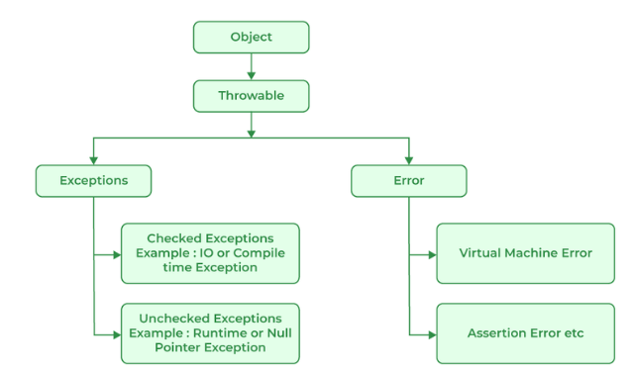
Java Exception Hierarchy
All exception and error types are subclasses of the class Throwable, which is the base class of the hierarchy

Slide 34
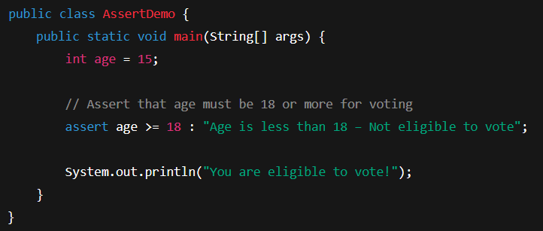
Assertion Error
An assertion allows testing the correctness of any assumptions that have been made in the program.
An AssertionError in Java is a type of error that occurs when an assert statement evaluates to false.

Slide 35
Exceptions can occur due to between several reasons, such as:
Invalid user input
Device failure
Loss of network connection
Physical limitations (out-of-disk memory)
Code errors
Out of bound
Null reference
Type mismatch
Opening an unavailable file
Database errors
Arithmetic errors

Slide 36
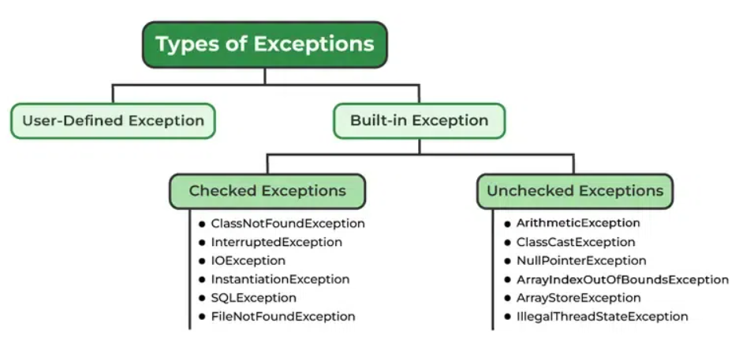
Types of Exception Handling

Slide 37
Exceptions Category
Built-in Exceptions
Checked Exception
Unchecked Exception
User-Defined Exceptions

Slide 38
Built-in Exception
Build-in Exception are pre-defined exception classes provided by Java to handle common errors during program execution.
Two types
Checked Exception
Unchecked Exception

Slide 39
Built-in Exception - Checked Exceptions [Compile Time]
ClassNotFoundException: Throws when the program tries to load a class at runtime but the class is not found.
InterruptedException: Thrown when a thread is paused and another thread interrupts it.
IOException: Throws when input/output operation fails
InstantiationException: Thrown when the program tries to create an object of a class but fails because the class is abstract, an interface, or has no default constructor.
SQLException: Throws when there's an error with the database.
FileNotFoundException: Thrown when the program tries to open a file that doesn’t exist

Slide 40
Built-in Exception - UnChecked Exceptions [Runtime]
ArithmeticException: It is thrown when there's an illegal math operation.
ClassCastException: It is thrown when you try to cast an object to a class it does not belong to.
NullPointerException: It is thrown when you try to use a null object (e.g. accessing its methods or fields)
ArrayIndexOutOfBoundsException: This occurs when we try to access an array element with an invalid index.
ArrayStoreException: This happens when you store an object of the wrong type in an array.
IllegalThreadStateException: It is thrown when a thread operation is not allowed in its current state

